Slide 1

The Danish Scenario: taking Danish National Bibliography reuse to the next level
Opening up the bibliography for the future
Carsten H. Andersen
Director of Bibliographic Services, DBC

Slide 2
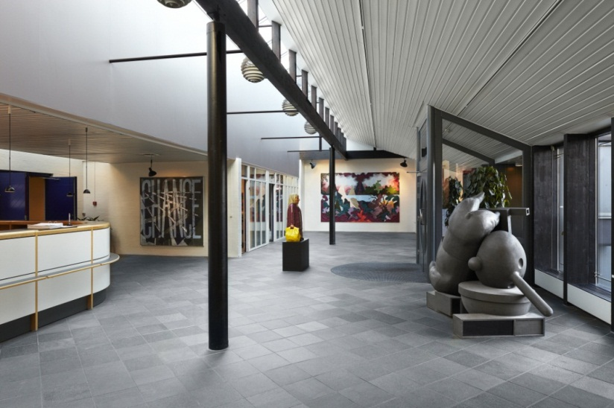
DBC – facilitating library collaboration
DBC (Danish Bibliographic Centre)
Limited company, not for profit
Shareholders: the state & LGDK (Local Government Denmark)
Staff: approx. 165
Major activities
National bibliography & library metadata enhancements: same record, same process
National infrastructure, union catalog:
  Danbib for library professionals
  Bibliotek.dk for end users
Metadata creation and national infrastructure on behalf of the libraries

Slide 3
The Danish National Bibliography
Produced by DBC Year 2012
Books: print and online 22.831
Audiobooks: discs and online 3.141
Video: discs and online 3.844
Video games: discs and online 212
Music recordings: vinyl, discs and online 3.505
Articles: print and online 30.232
Reviews: print and online 13.718
In some cases, registration of online resources is representative rather than exhaustive.
The NB exists as bibliographic records only.
Produced by the Royal Library: Periodicals, Maps, Music scores

Slide 4
Danish metadata ecosystem characteristics
All public and school libraries subscribe to records created by DBC
The state has awarded a contract for producing major parts of the NB to DBC
DBC collaborates with the publishing industry and legal deposit institutions
The book trade relies on NB metadata rather than the other way around
NB data is state property and free to use

Slide 5
Danish metadata ecosystem characteristics
… meaning …
Libraries and book trade depend heavily on NB
Timeliness is crucial: NB items are received from publishers – legal deposit as fall back
Metadata production synergies: NB and library metadata in one process and in one record
All libraries share records at a logical level

Slide 6
Danish metadata ecosystem characteristics
Local ILS
Local ILS
Annotations, subject headings etc.
Union catalog
Book trade
National bibliography
1 title = 1 record
record

Slide 7
Opening up the bibliography
Adding open functionality
Integration with aggregated datasets
Integration with
library specific annotations,
subject headings etc.
WWW
search engines
National bibliography
Bibliographic record
Linked
Open Data
Unrestricted,
free of charge usage

Slide 8
Adding open functionality to metadata
Webservice
DanBib
(Union catalog)
Functionality
Webservice
Webservice
Web service
Metadata
Data well
Migrating to a Service Oriented Architecture (SOA)

Slide 9
The data well – more than bibliographic records
Structured data
Full text
Data well
Structurize
Harmonize
Relate
Index
Images
Audio
Video

Slide 10

The data well – relating NB data to aggregated data
User contributed data
Listen to the audio book
About the author
Read the ebook
The critics say
Record with NB
and library data
Literary analysis
Watch the TV-series
About the subject
Listen to the soundtrack
Others, who borrowed…

Slide 11
Web services – interacting with the metadata
Search
Format
Resource
sharing
Input
Ref.
questions
User
contrib. data
ERM
Universal
search
3. party repository
Data well
Configure

Slide 12
A national multipurpose infrastructure
Library OPAC
user interface
Consortial e-service
user interface
National children’s OPAC
user interface
Search
Format
Resource
sharing
Input
Ref.
questions
User
contrib. data
ERM
Universal
search
3. party repository
Data well
Configure
Build applications picking data sets and web services

Slide 13
The data well infrastructure
– a national framework for collaboration
SOA means cost effectiveness: pay once, reuse infinitely
The data well infrastructure is LMS vendor independent and open
… which means that all libraries can collaborate to achieve even more
Innovative projects become sustainable services, because they are based on the national data well infrastructure
Collaboration also means sharing, and the data well serves as a data hub
Web services support collaboration and integration beyond the library community

Slide 14
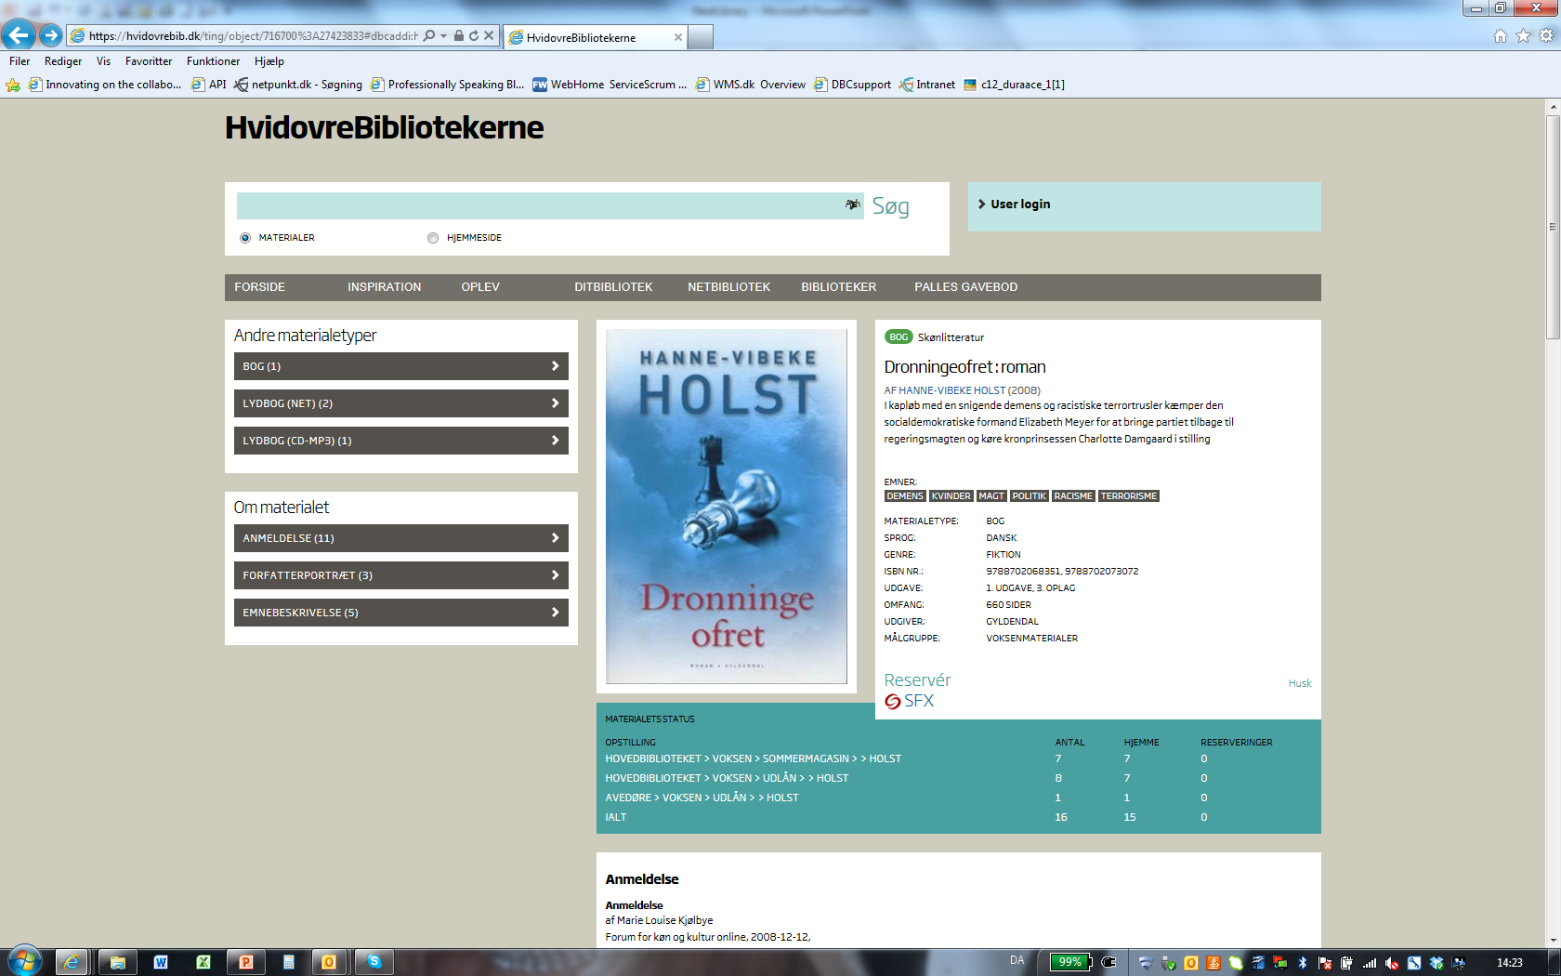
A multi purpose discovery platform

Slide 15
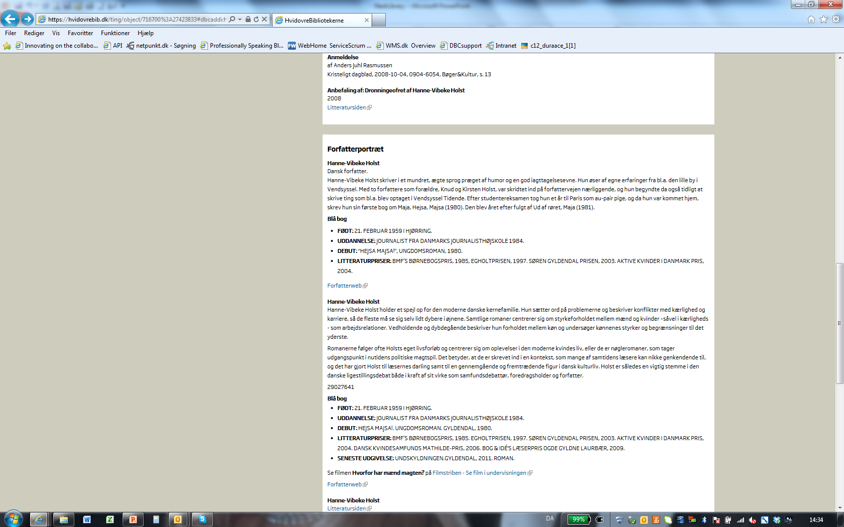
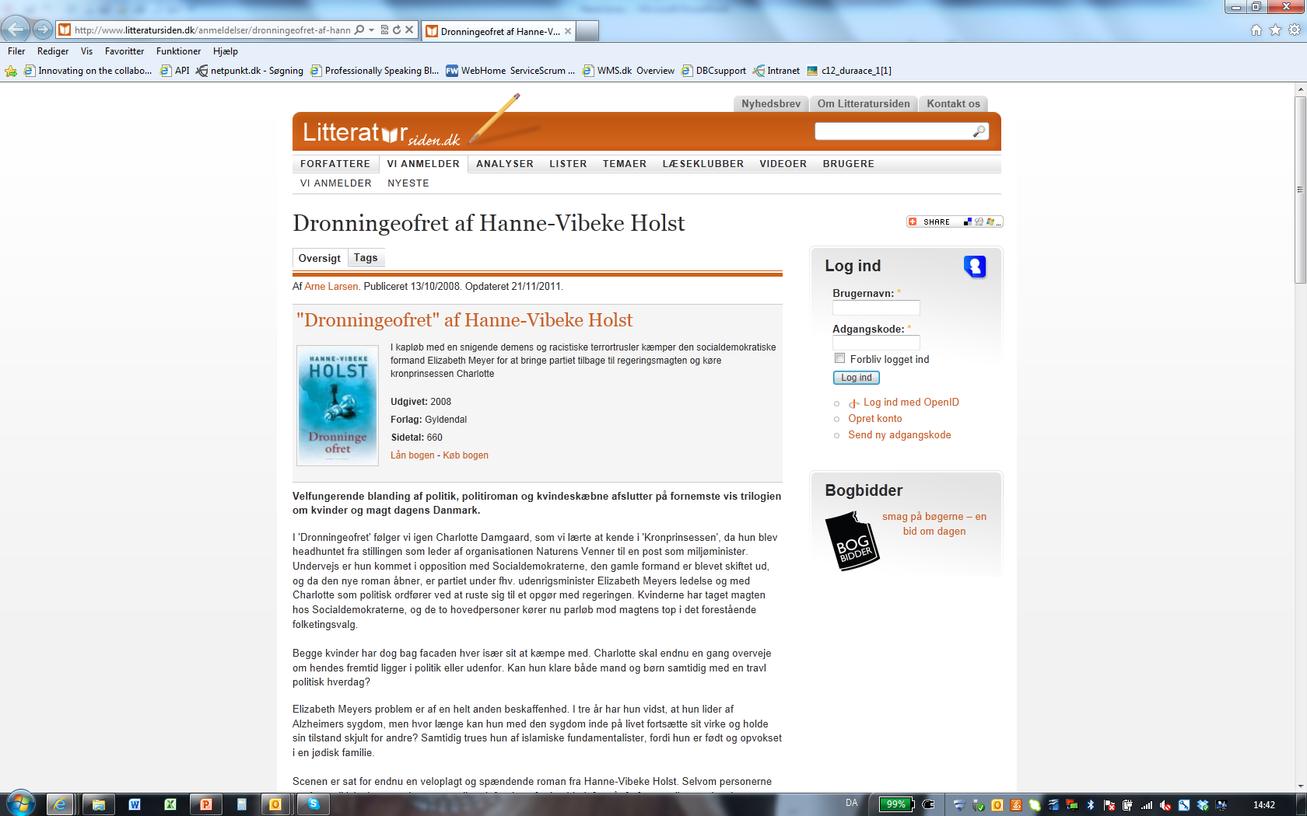
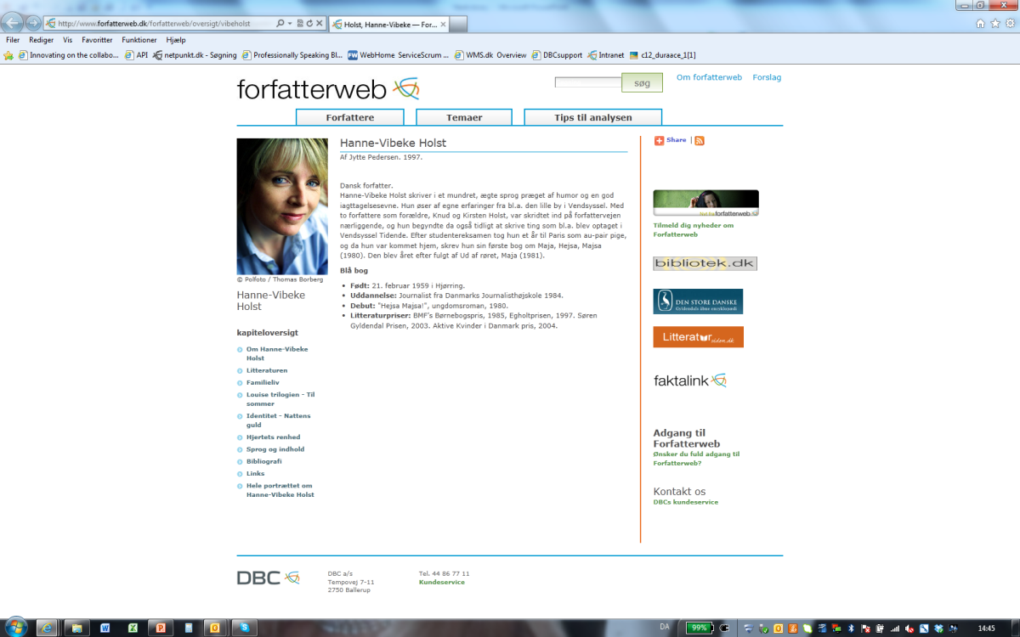
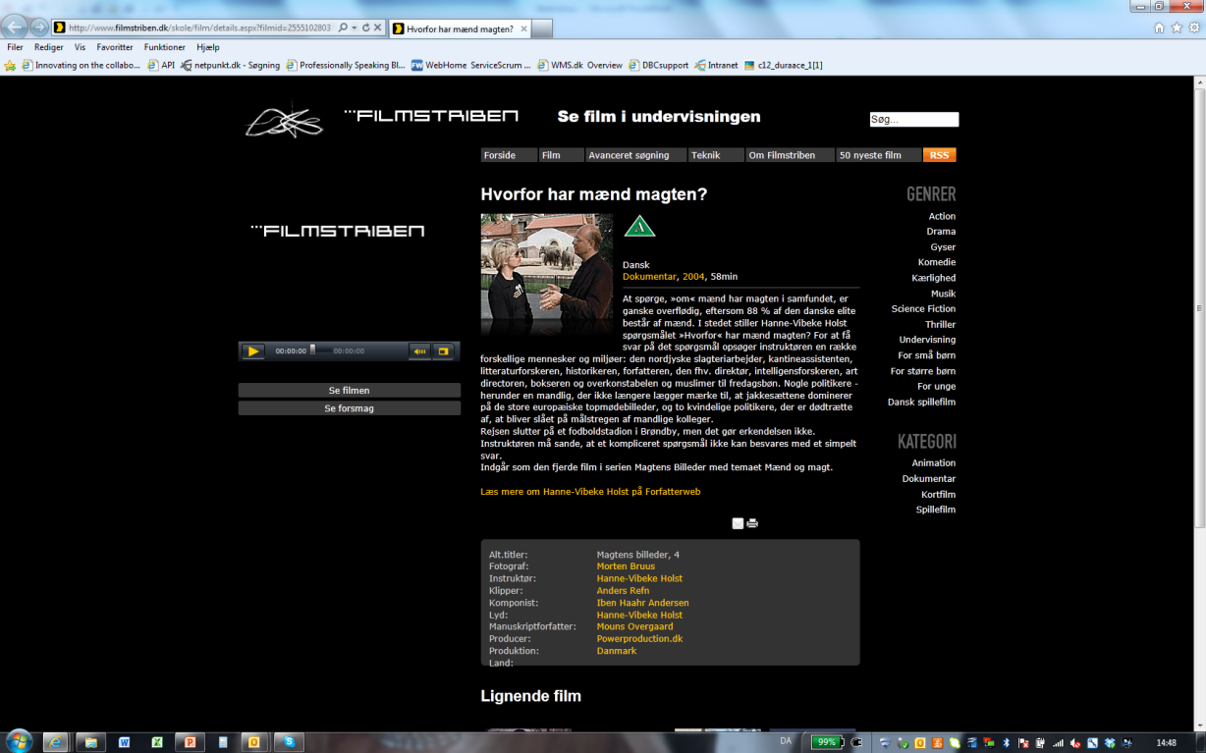

Slide 16
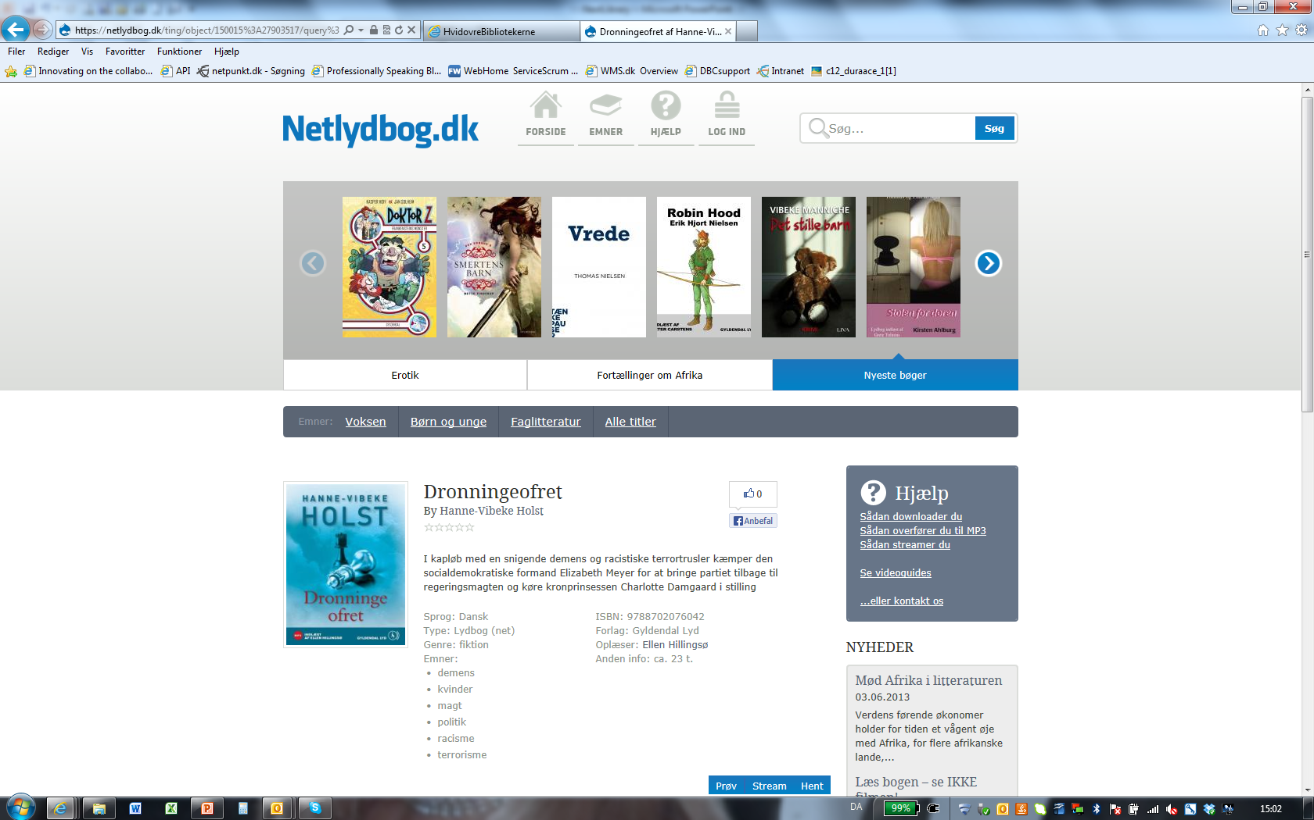

Slide 17
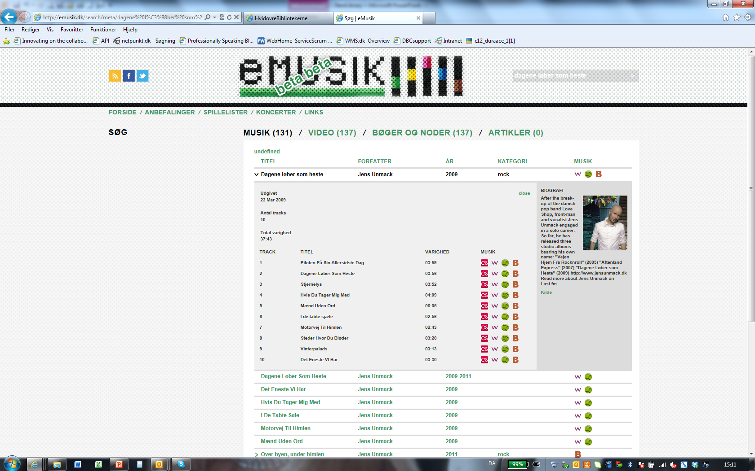

Slide 18
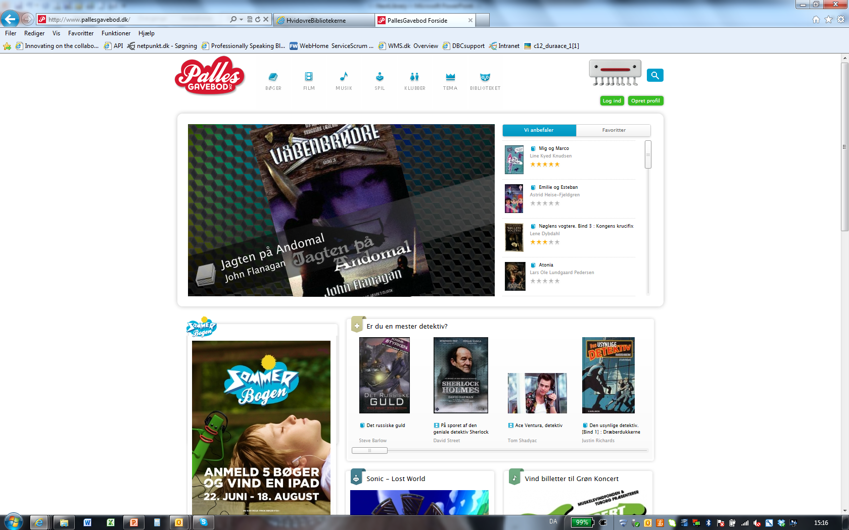

Slide 19
The data well serving as ILS back office catalog
Local ILS
Data well
DBC
Changing from metadata
replication ….

Slide 20
The data well serving as ILS back office catalog
Local ILS
Catalogue
webservice
Search
webservice
Format
webservice
Data well
DBC
… to true metadata
sharing

Slide 21

The data well and WorldCat
Data well
Bibliographic records
OCLC control number
Close to real time syncronization with WorldCat

Slide 22
Conclusions
Contributions to opening up the Danish national bibliography
The national bibliography poses the core of library metadata
The national bibliography published as LOD
The national bibliography in WorldCat → web search engines
The national data well adds to the national bibliographic data integration to other datasets as well as functionality to do stuff with the data
The national data well allows for building applications directly on top of the national bibliographic data instead of replicating data to other systems

